Slide 1
Tax Microsimulation Model https://github.com/Revenue-Academy/Tax_Microsimulation

Slide 2
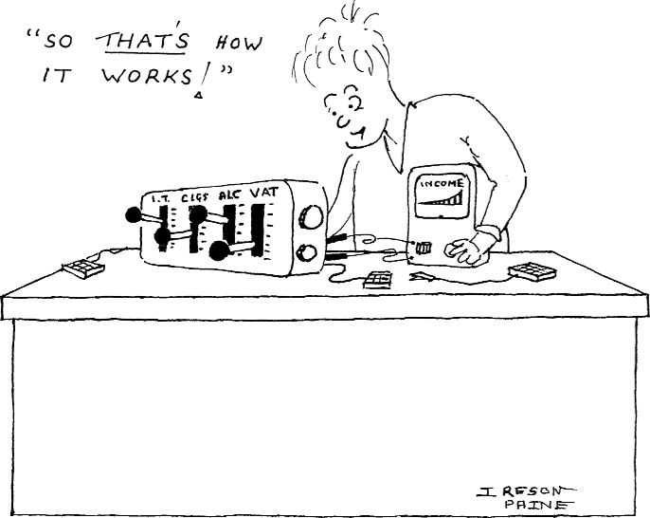
What Is A Tax Microsimulation Model?
Microsimulation model is a computer program that mimics micro-data.
Tax microsimulation model is a tool to calculate the tax liability of the country using micro-data of individuals.
Micro-data is accessed from the country’s tax return data or household income survey data of incomes under different categories including employment income/wages, investment Income & property income, etc.
This tool is situated in the World Bank’s repository named Revenue Academy (https://github.com/Revenue-Academy) which is on an open-source platform called GitHub where people can work on the software collaboratively.

Slide 3
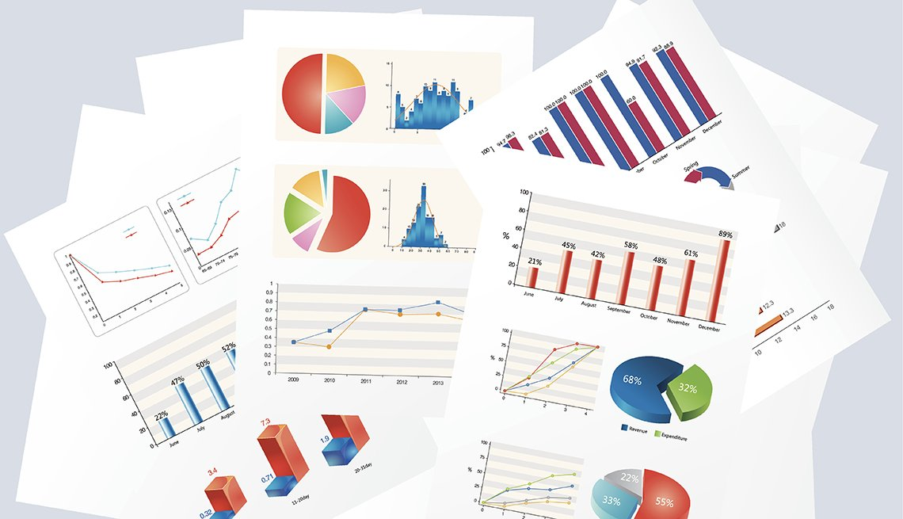
What Are Its Uses To A Policy Maker?
Tax rules can be complicated with complex formulas. This tool the advantage to see the effects of tax reforms with easy tweaks in the functions and formulas, while it could be a tedious task to do the same in a spreadsheet like excel.
It can also be used to see macroeconomic impact on growth, savings, employment & labor etc. Therefore, it not only calculates the tax revenue of the country but foresees what impacts the policy changes in tax can have on the economy as a whole.
The tool can also be further improved to see behavioral changes and adjustments.

Slide 4
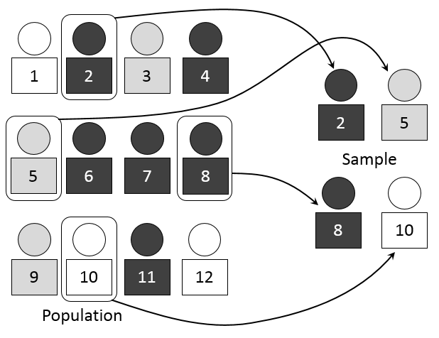
What Are The Key Inputs To The Model?
Data collection
the weighted sample should simulate the population DATA of country’s tax return forms.
The stratified sample size should depend on the variance in the population data.
The entire set of data records are not needed.
A good sample size is close to the tax logic of the country.
you also need to determine the rate at which the variables in the data are growing for future projections.
The variables’ growth rate can depend on the logic you apply to the specific variables, for e.g. it could be GDP growth rates, salary growth rate or income house salary growth rate depending on the rationale of the variable.
Records Module
Tax Return information
Data preparation including weights
Data description
Policy Module (and Policy Reform)
Calculator Module (and Tax Functions)
Grow Factors Module
Applications Module (app0, app1, app2 etc.)

Slide 5
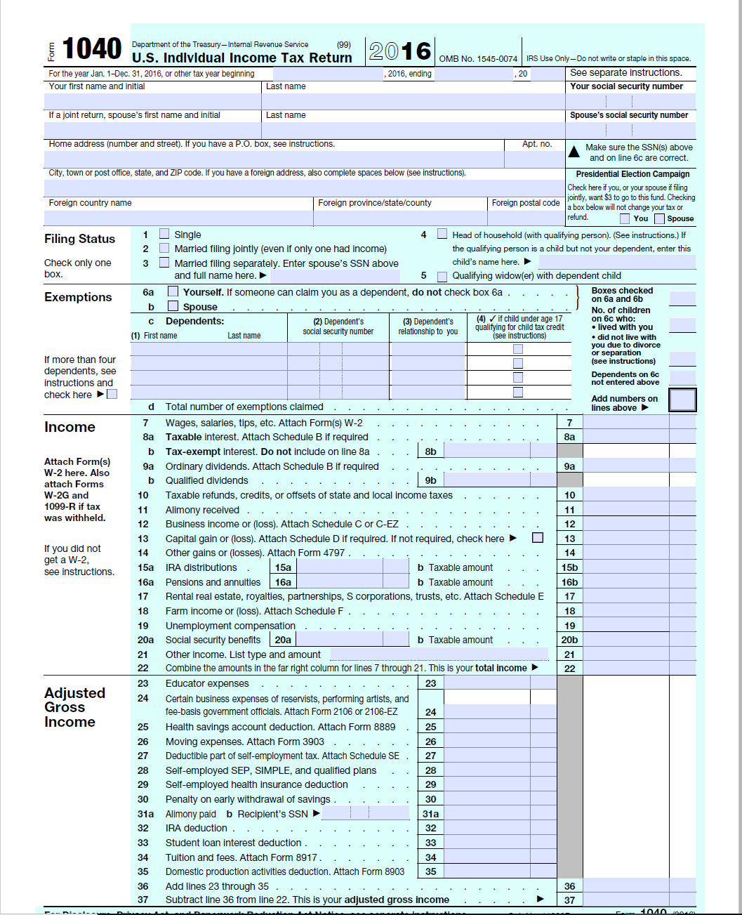

Could We Use Income Survey Data? What Are The Advantages?
Tax Return Form
For the purposes of data collection, tax returns forms are preferred over survey data as it is easier to obtain tax information from the tax return forms.
Good quality income or household surveys can be also be used. The only challenge would be to map the survey definition of what is being asked to the tax definition of what is used in the tax return form.
An advantage of survey data can be that it can provide much more information other than tax information about the individual which can be used for more interesting analysis.
Household Income Survey

Slide 6
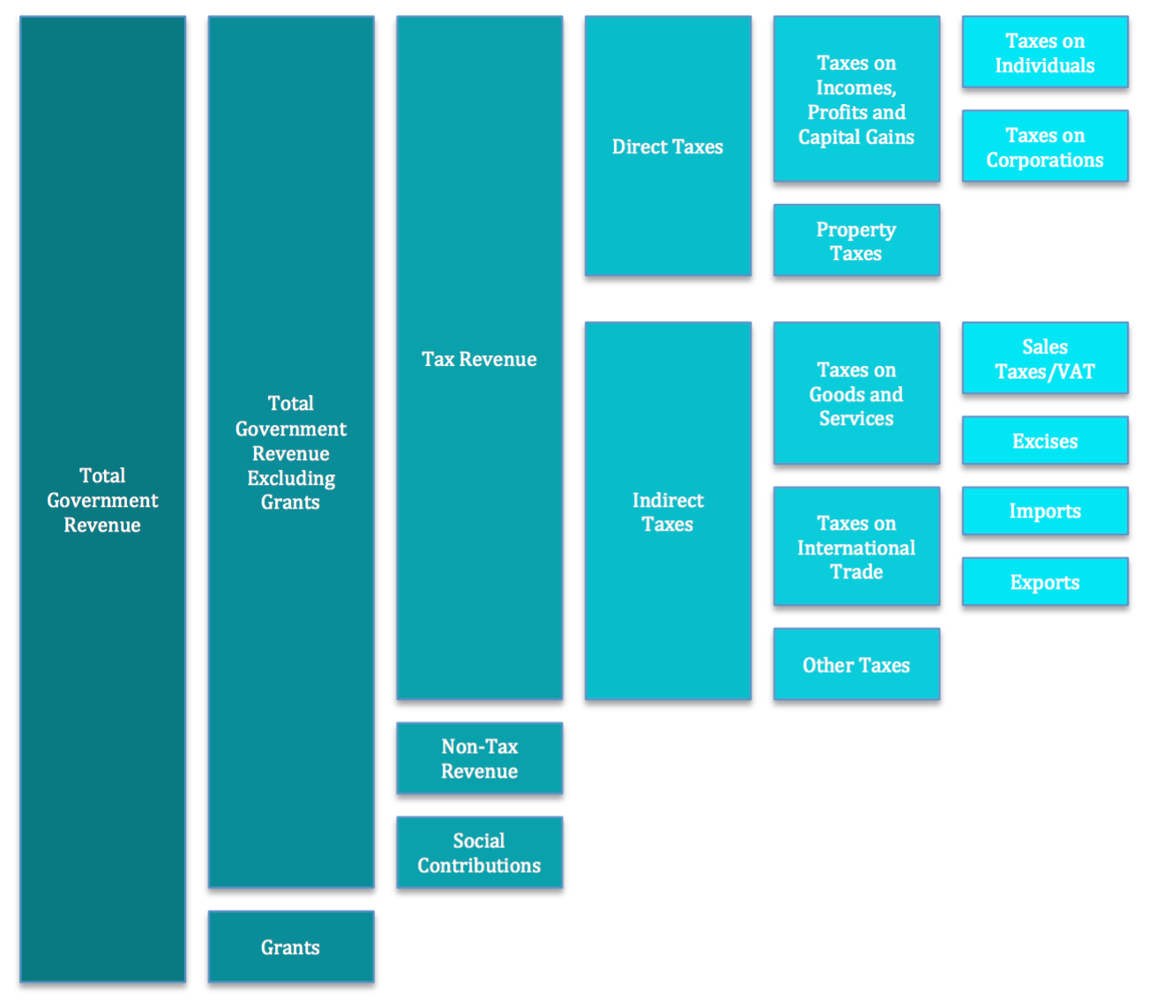
Analysis Can Cover Direct And Indirect Taxes
Analysis can cover multiple taxes such as VAT, Corporate Income Tax (CIT) & Cash Transfers, etc.

Slide 7
Some Outputs of The Microsimulation Model
Distributional tables
Distributional charts
Total Revenue in a year
Revenue forecast for multiple years
Breakdown of tax burden by income, region, industry, etc
Policy Simulation of revenue impact of specific reform proposals
Tax Expenditures

Slide 8
Distributional Tables
*** CURRENT-LAW DISTRIBUTION TABLE ***
Income Bracket (‘00000’) | Number of returns (‘00000’) | GTI | TTI | ... | rebate | surcharge | cess | PIT
<0 | 0 | 0 | 0 | ... | 0 | 0 | 0 | 0
0 | 125 | 0 | 0 | ... | 0 | 0 | 0 | 4554
0-5 | 111 | 334225 | 334225 | ... | 0 | 0 | 0 | 5732
5-10 | 91 | 651745 | 651745 | ... | 0 | 0 | 0 | 50745
10-15 | 61 | 720228 | 720228 | ... | 0 | 0 | 0 | 101656
15-20 | 19 | 336686 | 336686 | ... | 0 | 0 | 0 | 64876
20-30 | 16 | 378048 | 378048 | ... | 0 | 0 | 0 | 83306
30-40 | 3 | 101768 | 101768 | ... | 0 | 0 | 0 | 24509
40-50 | 0 | 0 | 0 | ... | 0 | 0 | 0 | 0
50-100 | 0 | 0 | 0 | ... | 0 | 0 | 0 | 0
>100 | 0 | 0 | 0 | ... | 0 | 0 | 0 | 0
ALL | 426 | 2522701 | 2522701 | ... | 0 | 0 | 0 | 335377
*** POLICY-REFORM DISTRIBUTION TABLE ***
Income Bracket (‘00000’) | Number of returns (‘00000’) | GTI | TTI | ... | rebate | surcharge | PIT | PIT Difference
<0 | 0 | 0 | 0 | ... | 0 | 0 | 0 | 0
0 | 125 | 0 | 0 | ... | 0 | 0 | 4554 | 0
0-5 | 111 | 334225 | 334225 | ... | 0 | 0 | 5732 | 0
5-10 | 91 | 651745 | 651745 | ... | 0 | 0 | 50745 | 0
10-15 | 61 | 720228 | 720228 | ... | 0 | 0 | 123662 | 22006
15-20 | 19 | 336686 | 336686 | ... | 0 | 0 | 93674 | 28798
20-30 | 16 | 378048 | 378048 | ... | 0 | 0 | 126800 | 43494
30-40 | 3 | 101768 | 101768 | ... | 0 | 0 | 38439 | 13930
40-50 | 0 | 0 | 0 | ... | 0 | 0 | 0 | 0
50-100 | 0 | 0 | 0 | ... | 0 | 0 | 0 | 0
>100 | 0 | 0 | 0 | ... | 0 | 0 | 0 | 0
ALL | 426 | 2522701 | 2522701 | ... | 0 | 0 | 443606 | 108229

Slide 9
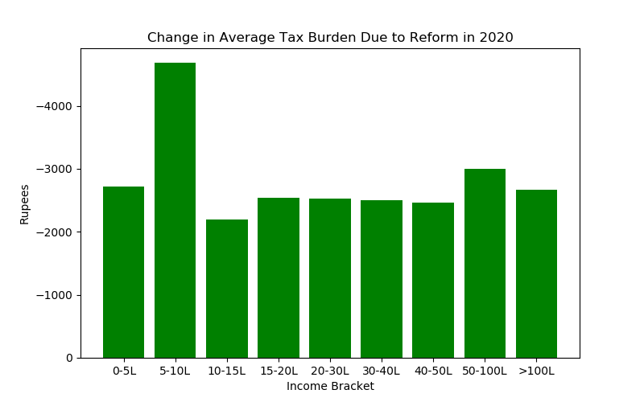
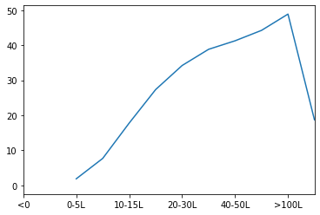
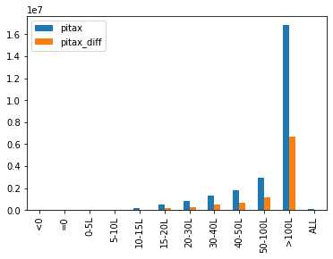
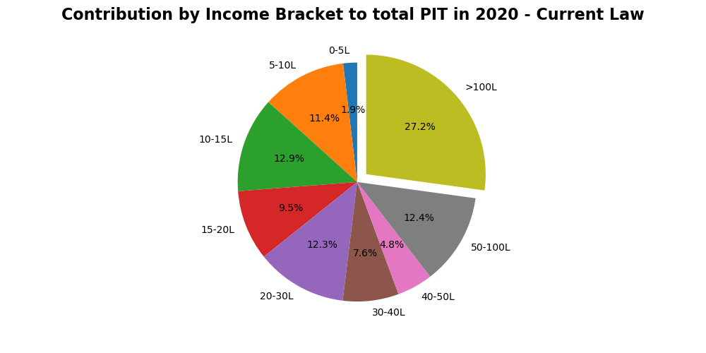
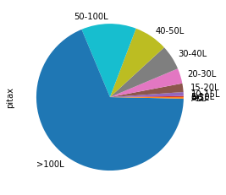
Distributional Charts
Effective Tax Rate

Slide 10

Total Revenue In A Year
* Total Tax Collection for 2019 * Current Law: Tax Collection in billions. for 2019: 3297.65 Representing: 426.42 billion taxpayers

Slide 11
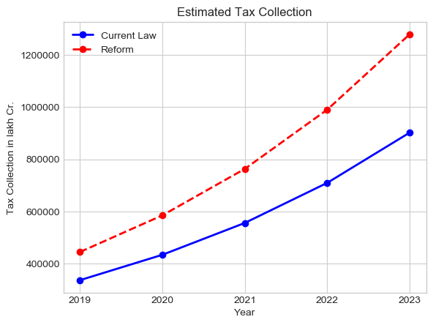
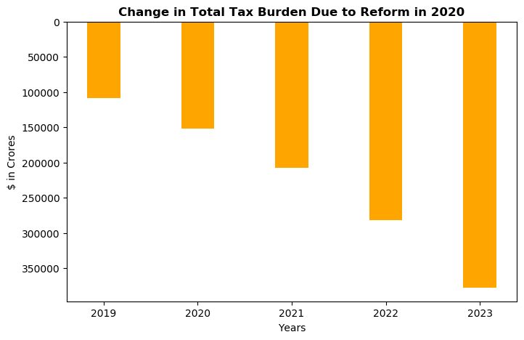
Total Revenue For Multiple Years/ Projections
**************** Total Tax Collection for 2020 **************** Current Law: Tax Collection in billions. for 2020: 4260.40 Representing: 469.06 billion taxpayers **************** Total Tax Collection for 2021 **************** Current Law: Tax Collection in billions. for 2021: 5467.72 Representing: 515.97 billion taxpayers
**************** Total Tax Collection for 2022 **************** Current Law: Tax Collection in billions. for 2022: 6985.48 Representing: 567.56 billion taxpayers

Slide 12
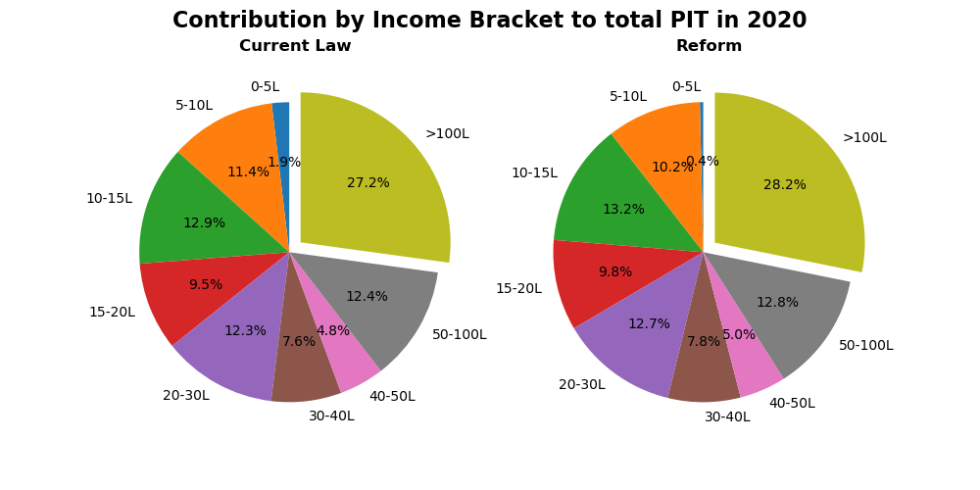
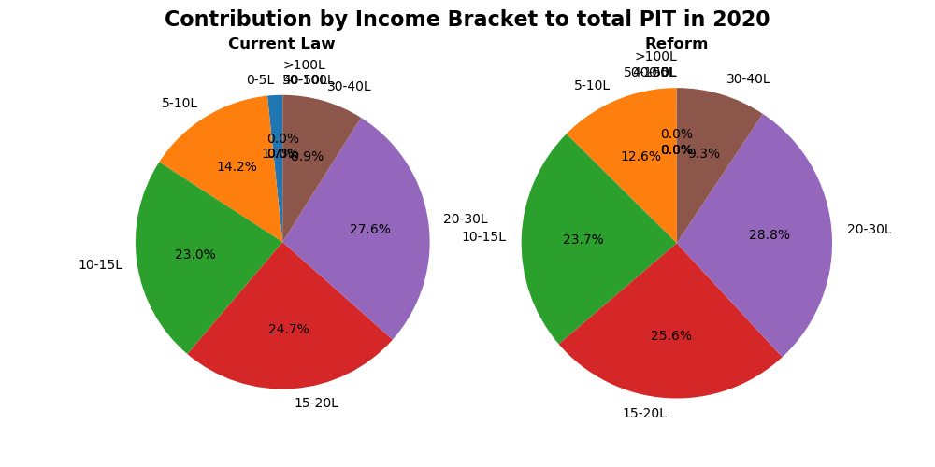
Breakdown Of Tax Burden By Income

Slide 13
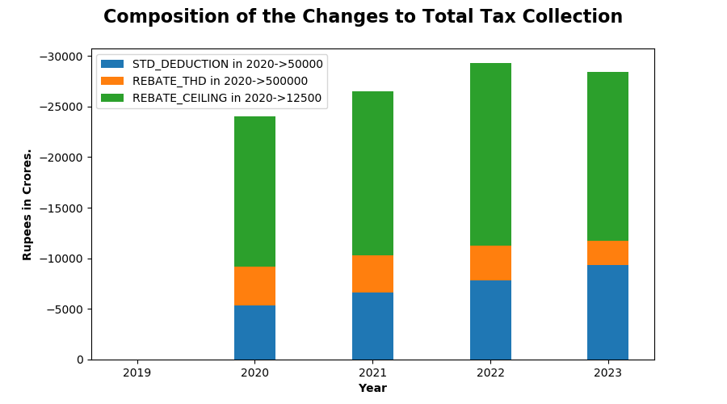
Breakdown of revenue impact of specific reform proposals

Slide 14
An Example of a Model Implementation

Slide 15
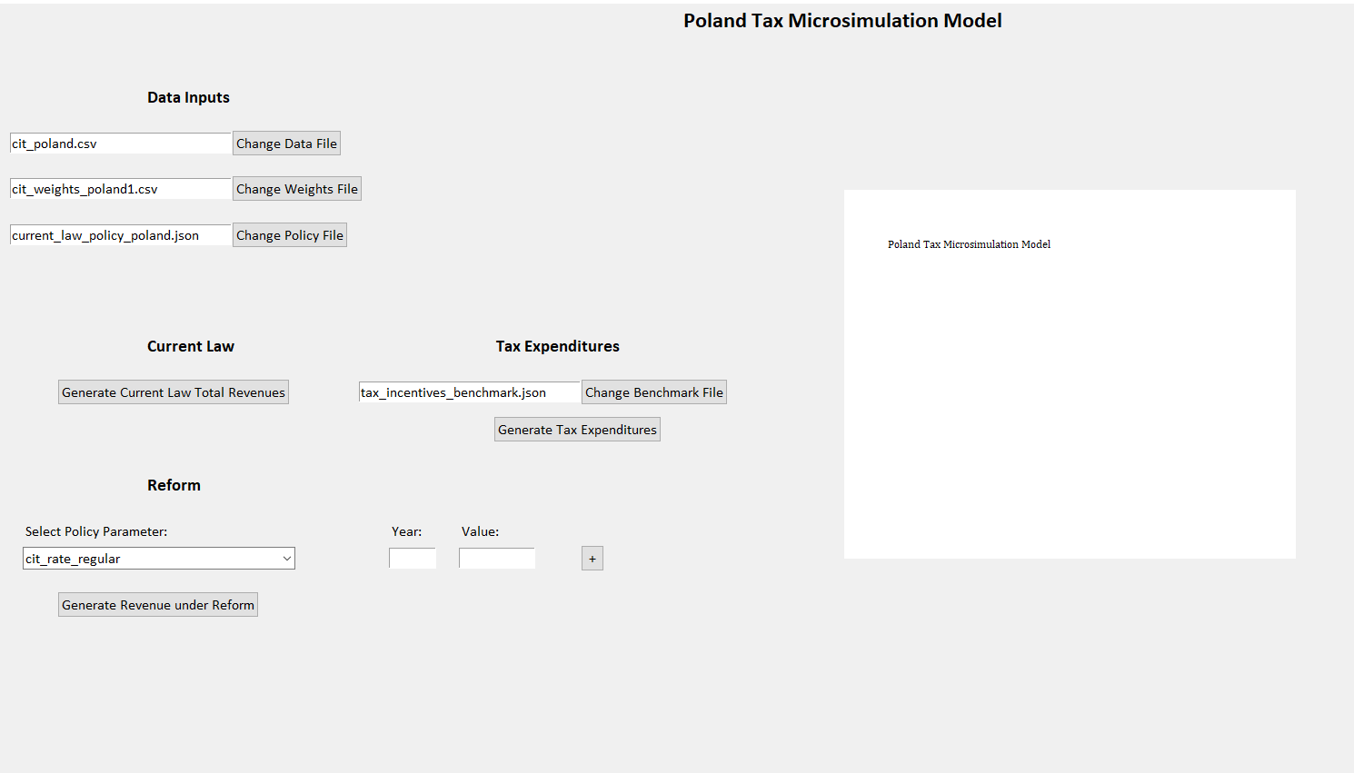

Slide 16
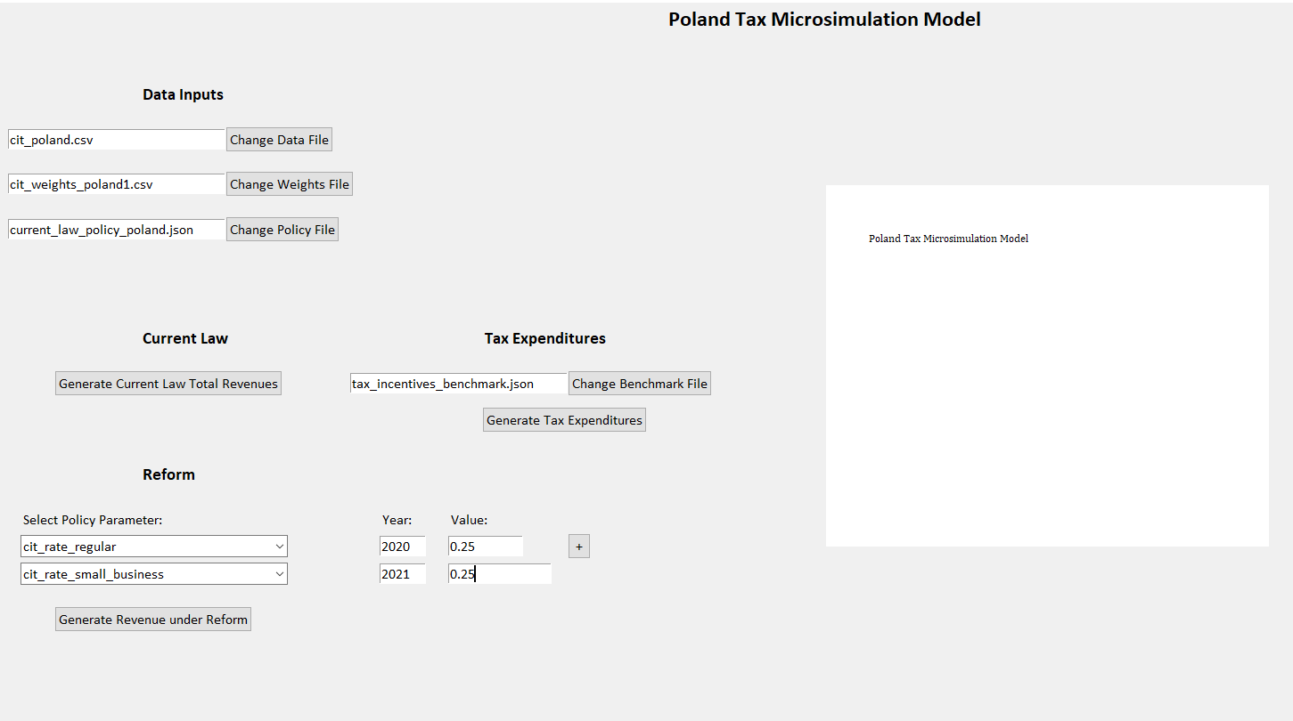

Slide 17
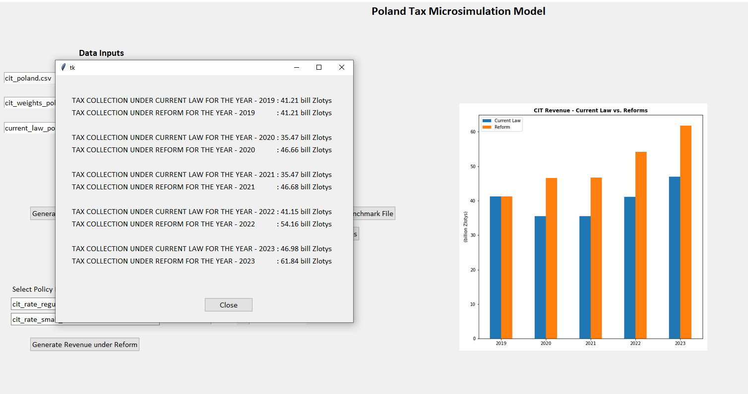

Slide 18
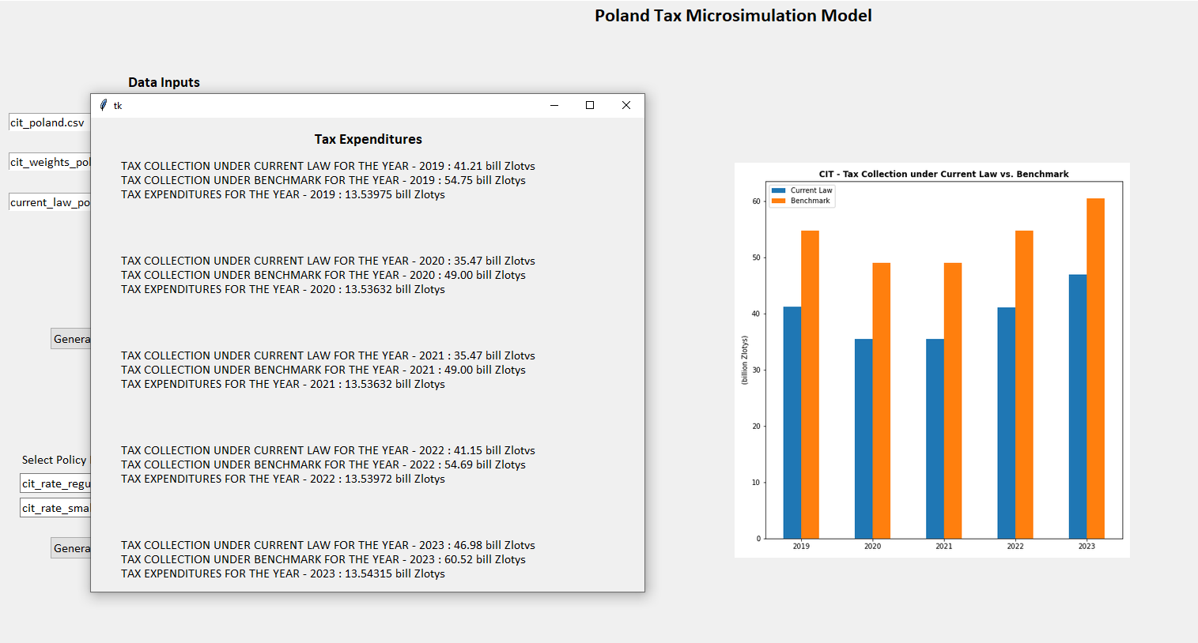

Slide 19
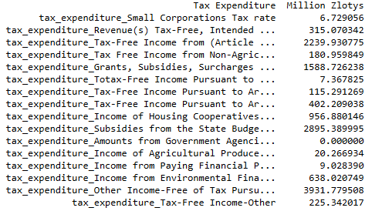
Detailed Tax Expenditures

Slide 20
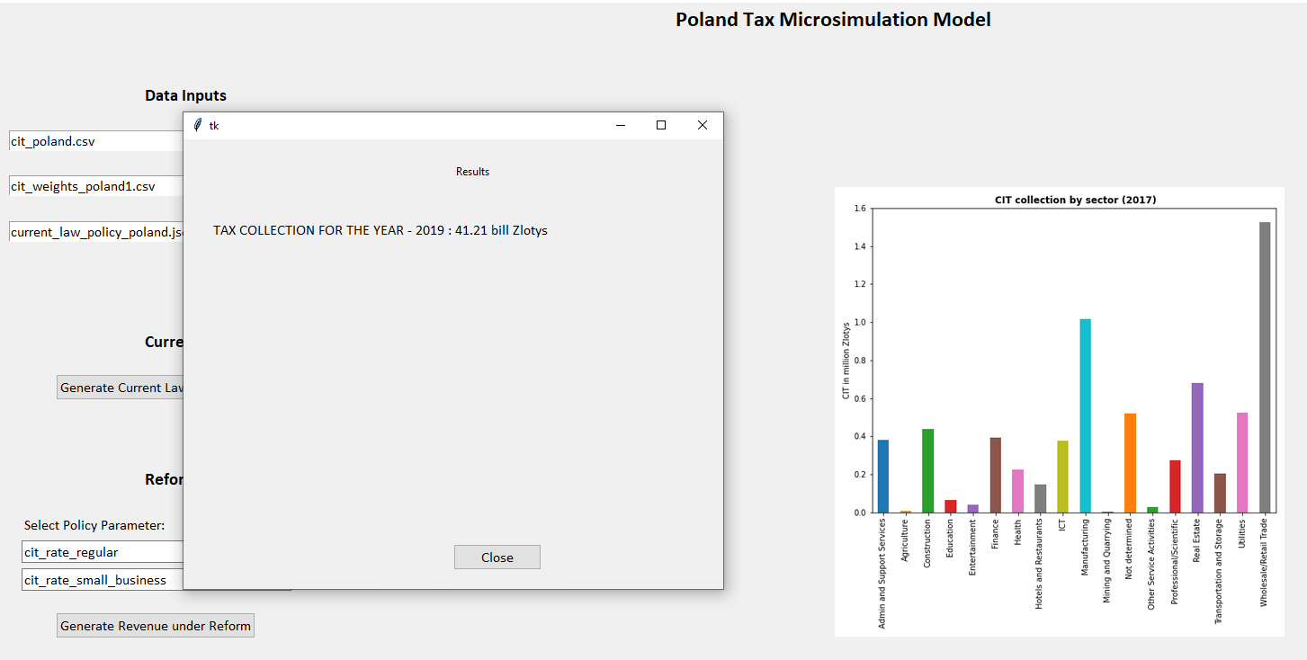

Slide 21
Further capabilities
Further capabilities of the Model includes:-
Behavioral analysis (elasticities) -How behavioral responses can have an impact on demand and supply elasticities resulting in tax changes
Growth dynamics - the reasoning behind the choice for grow factors can depend on various reasons:
Population growth
GDP growth
An econometric rationale for the variable from a study conducted ceteris paribus other factors
Increase/decrease in Labor Supply
Quality of Human Capital
Real Income
Interest Rates etc.
Negative Income Taxes
How to create a balance between income taxes and the welfare of the people and the economy?
Specific tax preferences can affect the allocation of economic resources. High marginal tax rates can discourage work, saving, investment, and innovation.
But tax cuts can also slow long-run economic growth by increasing deficits.

Slide 22
TRAINING SLIDES

Slide 23
Design of the Microsimulation Model
Records Module
Tax Return information
Data preparation including weights
Data description
Policy Module (and Policy Reform)
Calculator Module (and Tax Functions)
Grow Factors Module
Applications Module (app0, app1, app2 etc.)

Slide 24
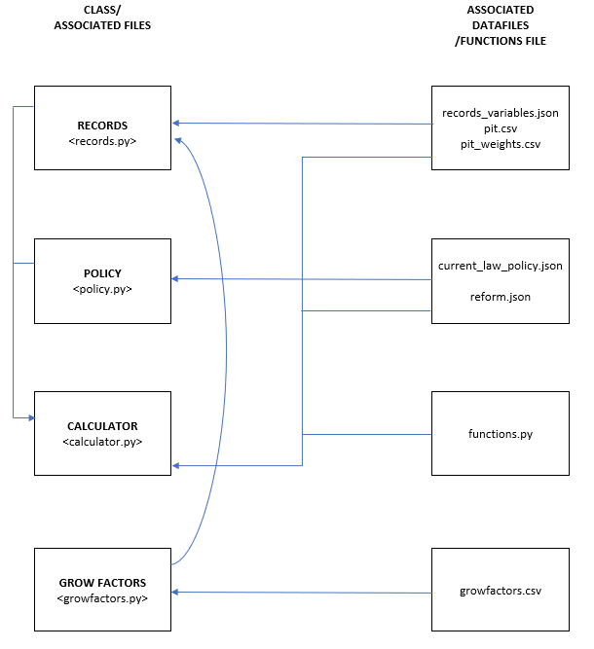
Structure of the Microsimulation Model
records_variables.json file defines all the variables from the tax return form aka the ‘red variables’ as well as the calculated variables.
Pit_weights.csv file has the representative weights of the records of the tax filers.
current_law_policy.json file defines the current law policy variables while changes in policy reforms can be made in reform.json files.
functions.py file does all the main tax calculations for e.g. the PIT tax.
growfactors.cvs file projects the growth percentage at which the variables (each line item) is growing every year.

Slide 25
Summary of Tasks
Setup the software
Import the pit.csv data into records.py
Import the pit_weights data into records.py
Build the records_variable.json file
Build the current_law_policy.json file
Import the current_law_policy.json file into policy.py
Incorporate growfactors
Write a short function to calculate the PIT

Slide 26
Reading the Data
Preparing the data to be read into the other modules (Tax Return Data and Survey Data)
Linking the pit.csv, pit_weights.csv and records_variables.json with Records Class
Linking the current_law_policy.json file with the Policy class
Update app1_reform.json with a reform using current_law_policy.json as the template
Run app0.py, app1.py
Run app2.py to introduce the idea of growfactors

Slide 27
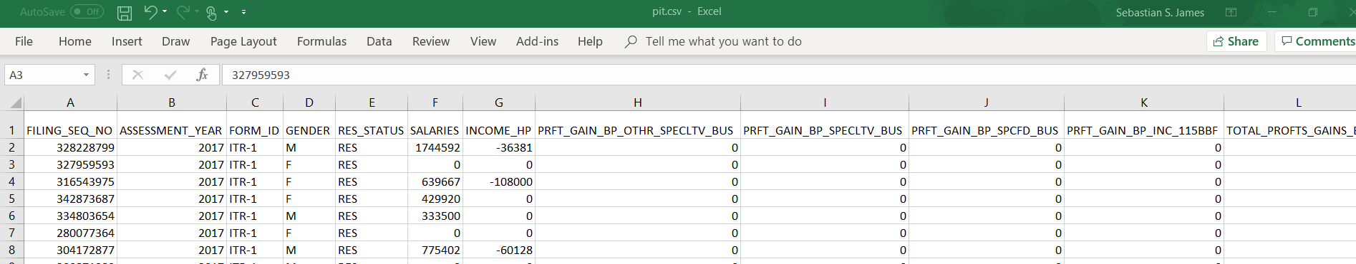
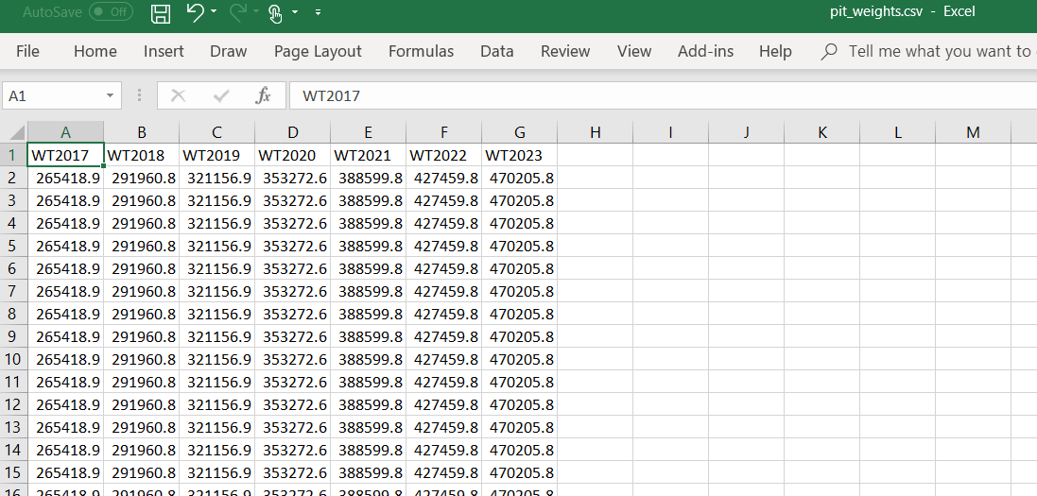
Data Input – pit.csv and pitweights.csv

Slide 28
Getting started with the model (Prerequisites)
GIT & Anaconda
Install git and python
Setup github and sync
Open an account with github.com
Download “git scm” (google it)
From eservices download “Anaconda Navigator” and install (you may need IT to help you with it)
We would need to run our python programs using “spyder” and the “Anaconda Prompt” which comes with the Anaconda package

Slide 29
Sync with the repository on github
Go to https://github.com/TPRU-India/taxcalc
Follow the instructions to sync with the repository
Fork the repository
Clone the repository
Create upstream channel

Slide 30
Example of an Output result from app0,app1,app2
TAX UNDER CURRENT LAW
Tax with a CHANGE IN reform
TAX PROJECTIONS
FILING_SEQ_NO AGEGRP SALARIES ... GTI TTI pitax
0 328228799 0 1744592 ... 1744592 1744592 348378
1 327959593 1 0 ... 0 0 0
2 316543975 0 639667 ... 639667 639667 52933
3 342873687 0 429920 ... 429920 429920 17992
4 334803654 0 333500 ... 333500 333500 8350
.. ... ... ... ... ... ... ...
195 268469599 0 0 ... 0 0 0
196 268472521 0 0 ... 0 0 0
197 268527911 0 0 ... 0 0 0
198 268532882 0 0 ... 0 0 0
199 268559295 0 731760 ... 731760 731760 71352
[200 rows x 12 columns]
Tax under Current Law: 2,157.07 billions
Total Returns: 35.24 million
Tax under Current Law: 2,157.07 billions
Tax under Reform: 2,211.94 billions
Total Returns: 35.24 million
Tax under Current Law for 2017: $2,157.07 billions
Tax under Reform for 2017: $2,211.94 billions
Total weight for 2017: 35.24 million
Tax under Current Law for 2018: $2,536.69 billions
Tax under Reform for 2018: $2,597.31 billions
Total weight for 2018: 38.77 million
Tax under Current Law for 2019: $3,297.66 billions
Tax under Reform for 2019: $3,364.64 billions
Total weight for 2019: 42.64 million

Slide 31
Writing Tax Functions
Writing tax functions for the Calculator Module
Create the function in functions.py
Declare the function and allow calculator class to run the function

Slide 32
Adding a new tax function
In all cases it is necessary to create a new tax function, say to calculate House Property income
This function is written in function.py
The function would require policy inputs (say a deduction) and some input/variable coming from the tax return/survey.

Slide 33
Adding a new tax function (2)
New tax functions are written in functions.py. Say the function is “calc_income_house_property”
The variables “INCOME_HP” is obtained from the Tax Return (or Survey) and hence is a “records” variable
“HP_deduction” is a policy variable
“Income_House_Property” is a calculated variable which reflects the income from House Property after Deduction and is included as a “records” variable
These Variables are added to the Model using the procedure “Adding new Variables” (see below)
Note: Even though “Income_House_Property” is returned by the function, it is declared as an input at the function definition
@iterate_jit(nopython=True) def calc_income_house_property(HP_deduction, INCOME_HP, Income_House_Property): Income_House_Property = INCOME_HP - HP_deduction return Income_House_Property

Slide 34
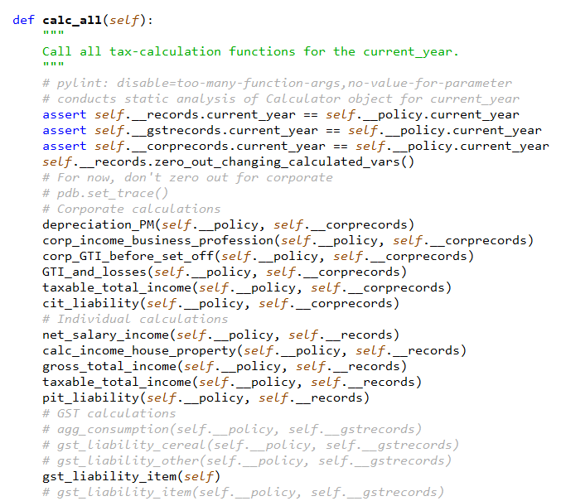
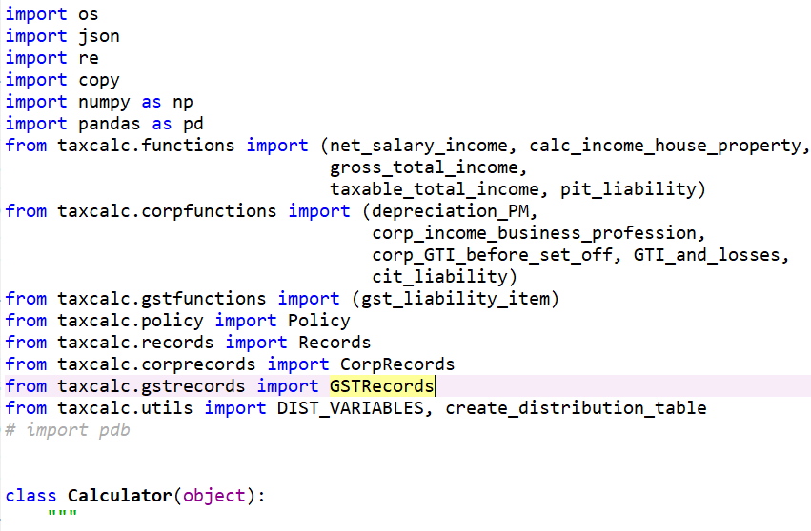
Adding a new tax function (3)
Connect the new function with the calculator.
This is done by updating calculator.py in two places.
At the beginning where we import it and,
In calc_all function where we call the function.
Note: The declaration in calc_all function looks for “self.__policy” variables and “self.__records” variables hence the order of the input variables declared in the functions.py has to be in the same order – policy and then record variables.

Slide 35
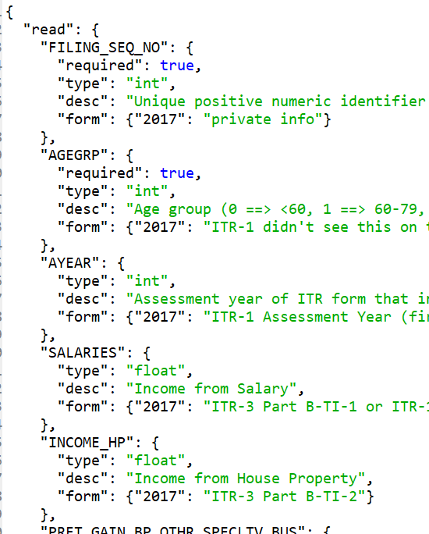
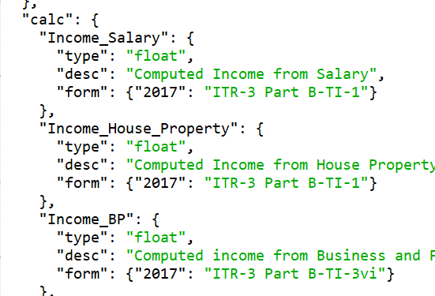
Adding a new Variable
Declare the variables in the respective json files.
“INCOME_HP” and “Income_House_Property” are declared in records_variable.json. “INCOME_HP” is declared as a “read” variable as it is directly read from the tax return/survey while “Income_House_Property” is declared as a “calc” (calculated) variable.

Slide 36
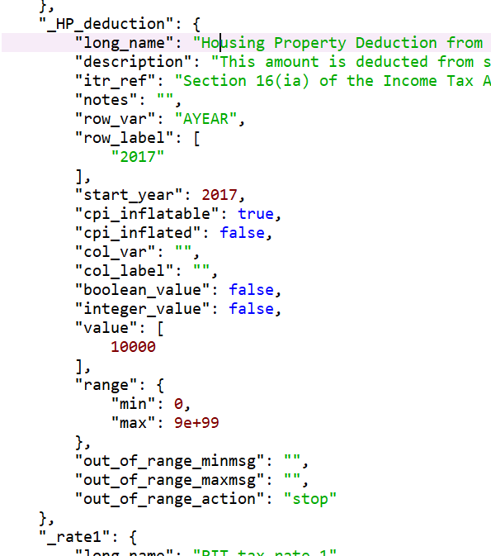
Adding a new Variable (2)
“HP_deduction” is a policy variable and is declared in current_law_policy.json.

Slide 37
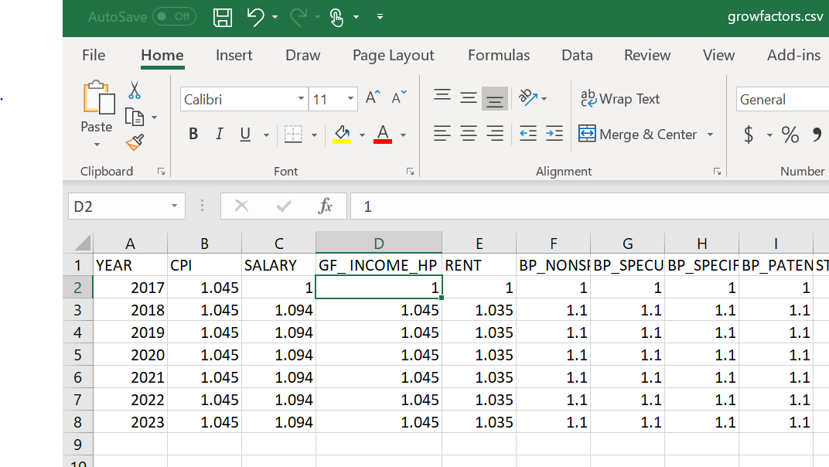
Adding a new Variable (3) - if different growth rate from CPI
Next, “read” variables are likely to grow with time and hence we need to incorporate their growth in “growfactors” files and functions.
In case we want the variable “INCOME_HP” to grow at a certain defined rate, we first update “growfactors.csv” putting the growth rate of the variable “GF_INCOME_HP”. In case the variable grows at the rate of CPI, a separate column need not be used, however the subsequent steps (below) need to be done to reflect the growth of the variable.

Slide 38
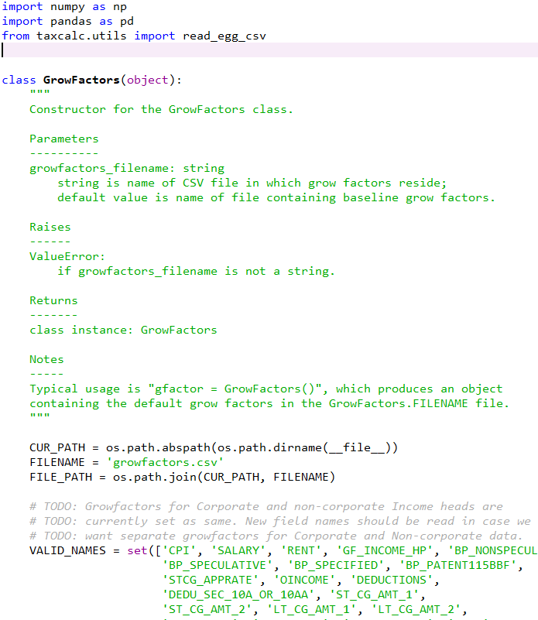
Adding a new Variable (4) - if different growth rate from CPI
We now need to “blow up” the INCOME_HP by this growfactor “GF_INCOME_HP” every year so we update growfactors.py
We then include the variable “GF_INCOME_HP” as a “VALID_NAME” in the “GrowFactors” Class

Slide 39
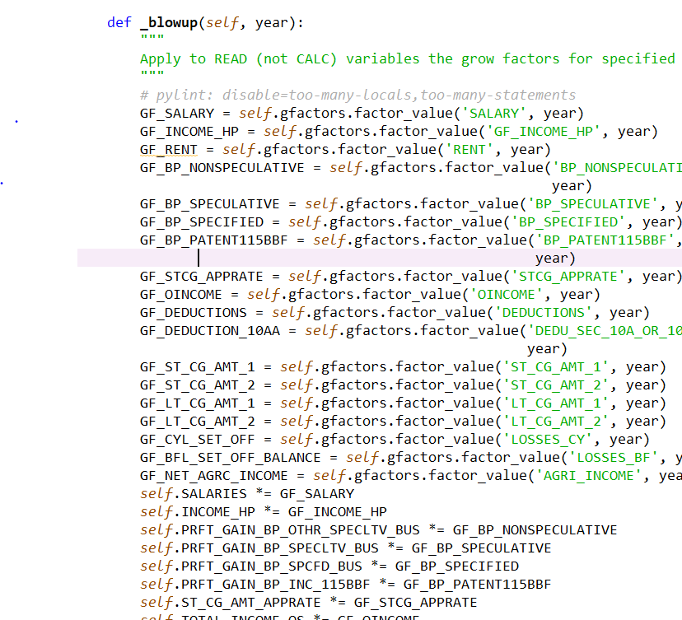
Finally, we need to update the records each year at the respective growth rates. This is done in records.py in the _blowup function.
First “import” the variable “GF_INCOME_HP” from the growfactors.csv file (in the example below we use the same name but this need not be the case). We then update the INCOME_HP with INCOME_HP*GF_INCOME_HP.

Slide 40
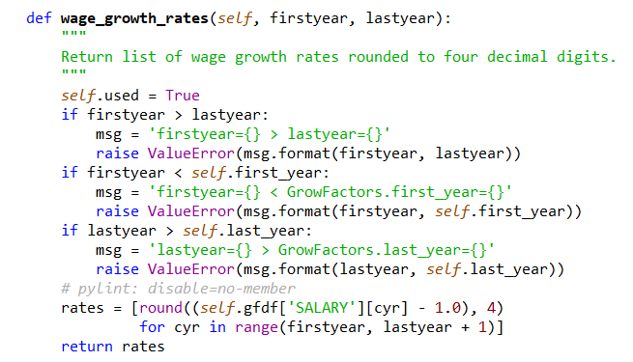
Change the variable that reflects the Wage growth
This variable is in the growfactors.csv file It may be either ‘SALARY’ or ‘GROSS_INCOME’ , etc.

Slide 41
Running baseline case
from taxcalc import * | { import all the required files from the taxcalc directory }
recs = Records() | { create a record object that consists of data from the pit.csv file or any file the records class is pointing to }
pol = Policy() | { create Policy object containing current-law policy }
calc1 = Calculator(policy=pol, records=recs, verbose=False) | { specify Calculator object for current-law policy }
calc1.calc_all() | { run all the tax calculation functions of the current year }
weighted_tax1 = calc1.weighted_total('pitax') | { save aggregate results from the calculators. Total tax calculated the weighted sum of the variable in brackets. In this case - ’pitax’ the personal income tax liability }
total_weights = calc1.total_weight() | { save the total weight of all the records which would be the total number of taxpayers.
print(f'Tax under Current Law: {weighted_tax1 * 1e-9:,.2f} billions') print(f'Total Returns: {total_weights * 1e-6:,.2f} million') | { print the results }

Slide 42
Implementing Reforms
calc1 = Calculator(policy=pol, records=recs, verbose=False) calc1.calc_all() # specify Calculator object for reform in JSON file reform = Calculator.read_json_param_objects('app1_reform.json', None) pol.implement_reform(reform['policy']) calc2 = Calculator(policy=pol, records=recs, verbose=False) calc2.calc_all() print('\n\n\n') # compare aggregate results from two calculators weighted_tax1 = calc1.weighted_total('pitax') weighted_tax2 = calc2.weighted_total('pitax') total_weights = calc1.total_weight() print(f'Tax under Current Law: {weighted_tax1 * 1e-9:,.2f} billions') print(f'Tax under Reform: {weighted_tax2 * 1e-9:,.2f} billions') print(f'Total Returns: {total_weights * 1e-6:,.2f} million')

Slide 43
Revenue Projections into the Future
for year in range(2017, 2020): calc1.advance_to_year(year) calc2.advance_to_year(year) calc1.calc_all() calc2.calc_all() weighted_tax1 = calc1.weighted_total('pitax') weighted_tax2 = calc2.weighted_total('pitax') weighted_tax_diff = weighted_tax2 - weighted_tax1 total_weights = calc1.total_weight()

Slide 44
Distributional Analysis
output_categories = 'standard_income_bins' dt1, dt2 = calc1.distribution_tables(calc2, output_categories, averages = True, scaling = True) dt1 = dt1.fillna(0) print(dt1) dt2['pitax_diff'] = dt2['pitax'] - dt1['pitax'] dt2['etr'] = (dt2['pitax']/dt2['GTI'])*100 dt2 = dt2.fillna(0) print(dt2) dt2[['pitax', 'pitax_diff']].plot.bar() plt.show() | If we need the distribution tables with average tax paid by each group we state averages = True Otherwise if we need the distribution tables with the total tax paid by each group we state averages = False If we need the distribution tables in deciles we state output_categories = ‘weighted _deciles' Otherwise if we need the distribution tables with the total tax pais by each group we state output_categories = 'standard_income_bins'

Slide 45
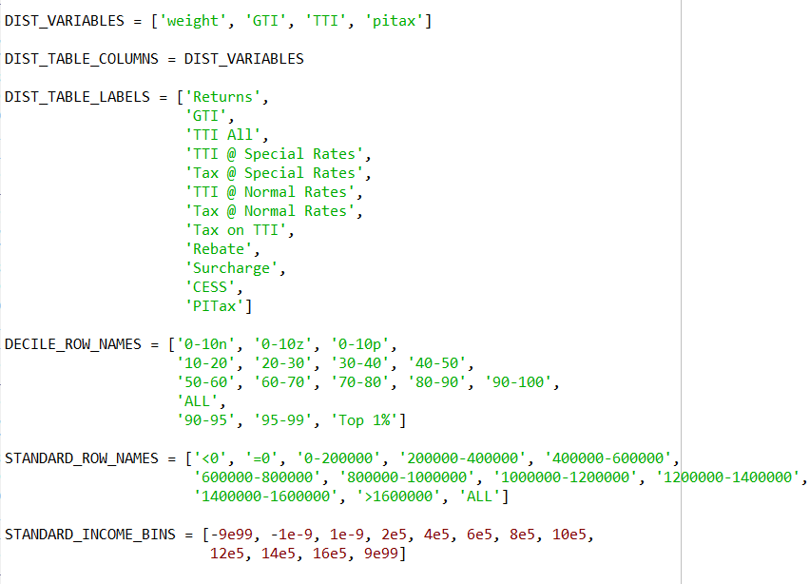
Distribution Tables
Include the variables on which the Tables are to be made
Define the row names for the deciles that will be displayed
Define the row names for the income bins that will be displayed
Define the actual bins values

Slide 46
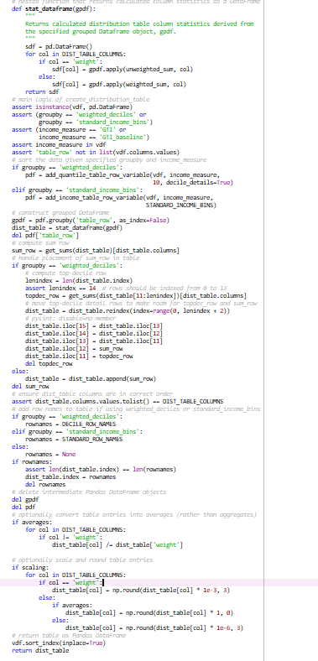
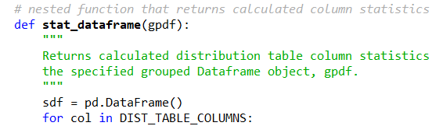
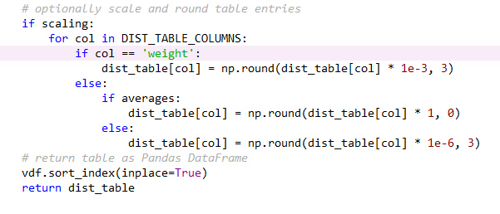
Changing the Scaling factor for the Distribution Tables

Slide 47
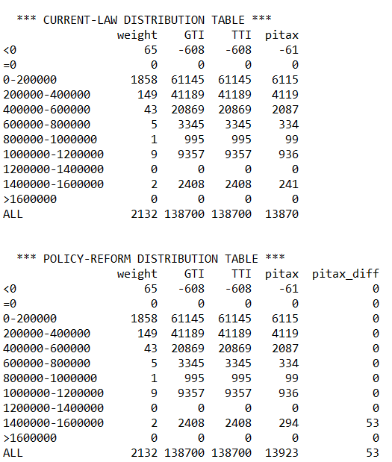
Output of the Distribution Table

Slide 48
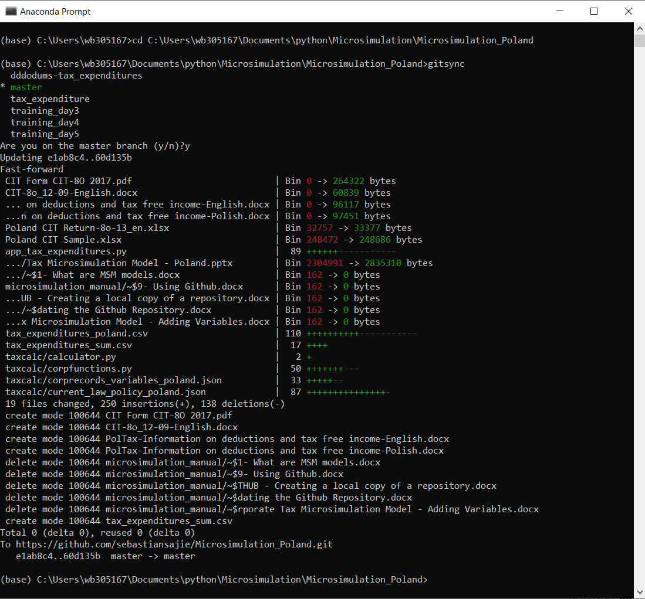
Syncing with the updated online repository:
Go to Anaconda Prompt, type the following commands to sync your local repository with your online one:
cd path/address of the folder on your computer
Type gitsync
Type ‘y’ if you are on master branch, If you are not on the master branch, type ‘n’ and then type git checkout master at the prompt
The local computer will now be updated with the latest version of the model from github

Slide 49
Tax Expenditures
The Microsimulation Model can estimate the tax expenditures (revenue foregone due to tax incentives)
This is done by calculating the difference in the tax calculated with and without the tax exemptions.
In the model this can be done by switching ‘on’ and ‘off’ the exemptions in the current_law_policy.json file and finding the difference in the tax calculated in these two modes.
As tax expenditures are a ‘static’ concept, there is no need to include behavioral impacts of switching the exemptions ‘on’ and ‘off.

Slide 50
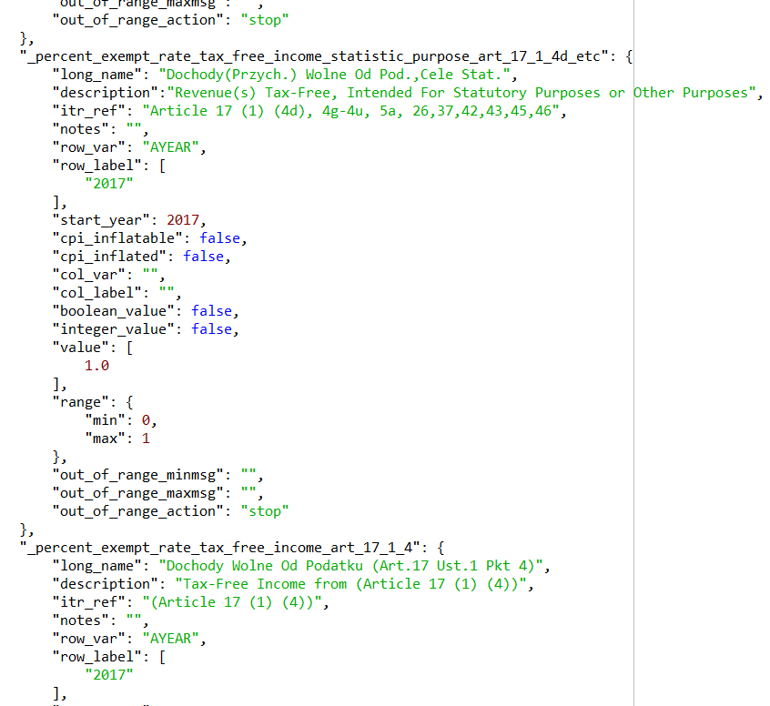
The exemptions are added to the current_law_policy json file
Note that in many cases the exemptions are switched ‘on’ and ‘off’ by applying either 100% of the exemption or 0% exemption, i.e. the “value” is between ‘1’ and ‘0’.

Slide 51
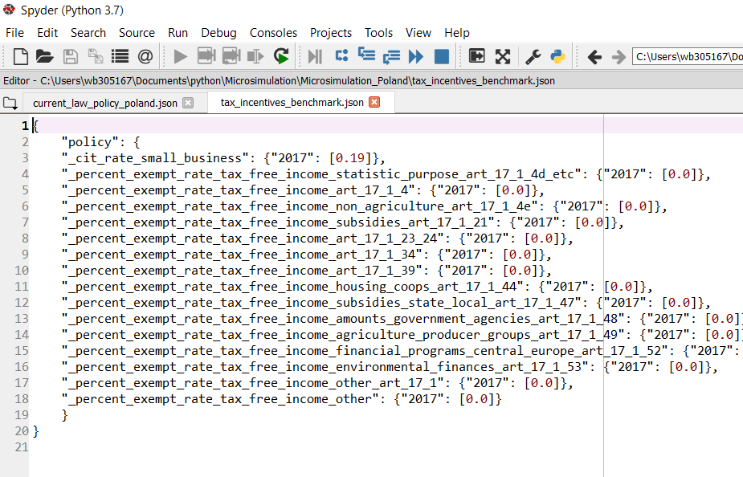
A new ‘benchmark’ policy json file is created
All the exemptions are included in the file tax_incentives_benchmark.json
The ‘benchmark’ implies no exemption, therefore the policy variable is switched to ‘0’. The tax collected in such a case would be the baseline against which the revenue foregone due to the exemption would be calculated.
When we apply the current law we get the tax collectible under the current law. When we switch off the exemption one-by-one by applying the ‘benchmark’ policy we get the baseline tax collectible.
The difference between the two gives us the revenue foregone or the tax expenditures as a result of the exemption.
We repeat the process for each of the exemptions in the ‘benchmark file.
The results are output into a csv file.

Slide 52
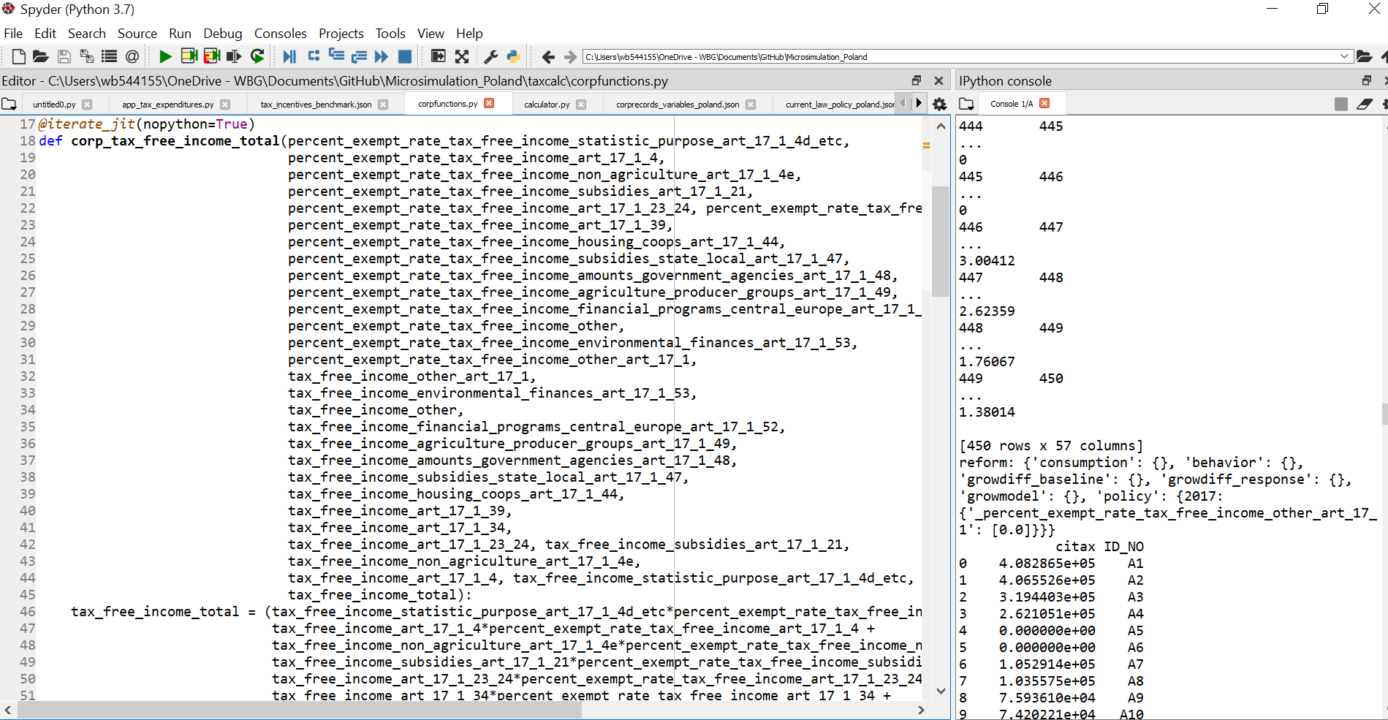
Variables & functions are added, changes are made to the following files
corpfunctions.py
calculator.py
corprecords_variables_poland.json
current_law_policy_Poland.json

Slide 53
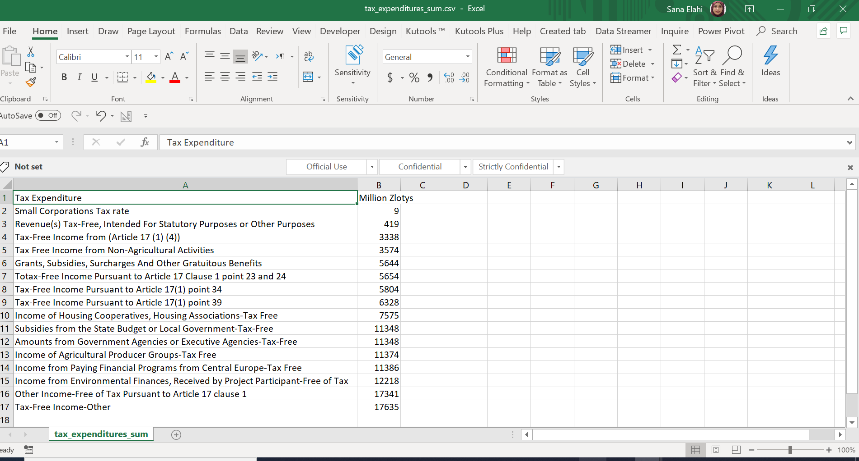
Results/Output of Tax Expenditures

Slide 54
Typical Errors when Running the Microsimulation
Error asking that variables need to be passed
Check if @iterate_jit is missing before each function in functions.py
Error showing ‘Policy not working’
Solution – restart kernel (but would work anyway in Anaconda Prompt)
Cannot find taxcalc
Not in correct working directory
Working in the wrong repository
Tax_Microsimulation instead of Microsimulation_Training
Errors with syncing
git stash (will stash away the change made and then allow the latest version in the repository to update the local version)

Slide 55
Typical Errors when Running the Microsimulation
Error: Records object has no attribute ….
or
Error: Policy object has no attribute ….
Variable used not declared in records or policy json file
records.py or policy.py points to the wrong records or policy json file
Error: function is not defined
function created in functions.py is not imported at top in the calculator.py file
Error: No change in the tax totals even after creating new function
new function is not being called in calculator.py

